Slide 1
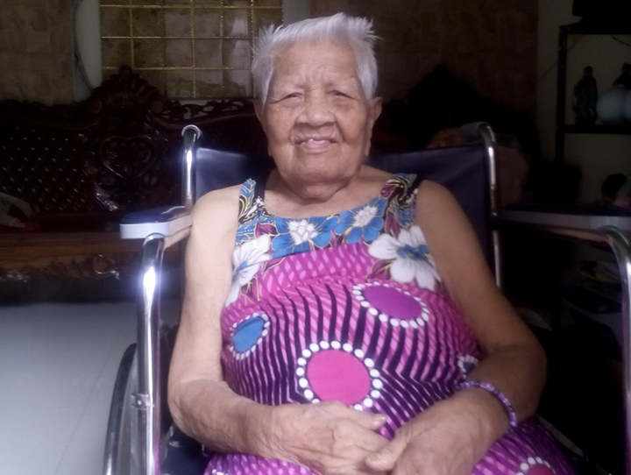
Mother’s Day
You are a great mother to me
Because you gave me life and show me the world
You are a special mother to me
Because you care and love me tenderly
You are a wonderful teacher to me
Because you teach and guide me all the time
With that, I wish you a great, special and wonderful Mother’s Day.

